Slide 1
Azure Administration

Slide 2



Cloud Computing
Flexibility Resources
On–demand Resources over the internet
Pay As You Go
Self – Service
Reliability
Fault Tolerance
High Availability
Security
Scalability
Elasticity
OpEx

Slide 3
Azure
Cloud Offering from Microsoft
Public Cloud

Slide 4
Azure Portal
Lets you build, manage and monitor everything in a single, unified console.
Search Resources
Manage Resources
Create customized dashboards
Access the cloud shell
Receive notifications

Slide 5
Azure Mobile App
Keep track of resources while on-the-go
Check status of critical metrics
Diagnose and fix issues quickly
Run commands to manage your Azure resources

Slide 6
Azure Cloud Shell
Interactive, browser-accessible shell for managing the Azure resources.
Flexibility of choosing the shell experience – CLI, Powershell

Slide 7
Azure CLI
https://learn.microsoft.com/en-in/cli/azure/install-azure-cli
CLI Commands - https://learn.microsoft.com/en-in/cli/azure/reference-index?view=azure-cli-latest

Slide 8
Azure PowerShell
https://learn.microsoft.com/en-in/powershell/azure/install-az-ps?view=azps-8.3.0
PowerShell commands - https://learn.microsoft.com/en-in/powershell/module/az.accounts/?view=azps-8.3.0#accounts

Slide 9
Azure Resource Manager

Slide 10
Resource Manager
Enables you to work with the resources in your solution as a group.
You can deploy, update or delete all the resources for your solution in one single coordinated operation.

Slide 11
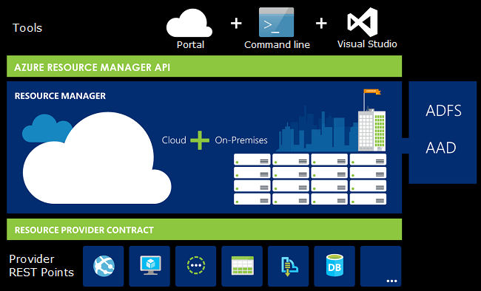

Slide 12
Benefits
You can deploy, manage and monitor the resources in your solution as a group
You can repeatedly deploy your solution in the same consistent state

Slide 13
Terminology
Resource – Manageable item that is available through azure. Ex: Virtual Machine, Storage Account, Web App, Database, Virtual Network
Resource Group – Container that hold the related resources for an azure solution
Resource Provider – A service that supplies the resources you can deploy and manage through the Resource Manager. Ex: Microsoft.Compute – Virtual Machine, Microsoft.Storage – Storage Account

Slide 14
Resource Group
Logical collection of resources
Resources can only exist in one resource group
Resource Groups cannot be renamed
Resource groups can have resources of many different types
Resource groups can have resources from many different regions.

Slide 15
















Slide 16
Creating Resource Group
Deploying a resource to resource group

Slide 17
Resource Manager Locks
Allows to put a structure in place that prevents the accidental deletion of resources in Azure.
Two Types:
Read-only lock – prevent any changes to the resource
Delete lock – prevent the deletion

Slide 18
Moving Resources
https://learn.microsoft.com/en-us/azure/azure-resource-manager/management/move-support-resources

Slide 19
Deleting Resources and Resource Groups
Please be cautious while deleting resource group.
Once deleted, resource groups cannot be recovered.

